Slide 1


Automated Offensive Content Detection in Videos
Hemant Gami
DS6A2117

Slide 2
Automated Offensive Content Detection in Videos
This project focuses on automatically detecting offensive content in videos. It transcribes the video, cleans the text, identifies offensive words, predicts suitability for children, and suggests relevant IPC sections.

Slide 3

Project Background & Motivation
Rising Concerns
Manual Moderation Inefficiency
Growing concerns exist regarding online content safety, especially for children.
Manual content moderation is time-consuming and expensive.
Need for Automation
Automated solutions are needed for faster and more accurate detection of harmful content.
The project aims to develop a system that can automatically detect offensive content in videos, ensuring a safer online environment.

Slide 4
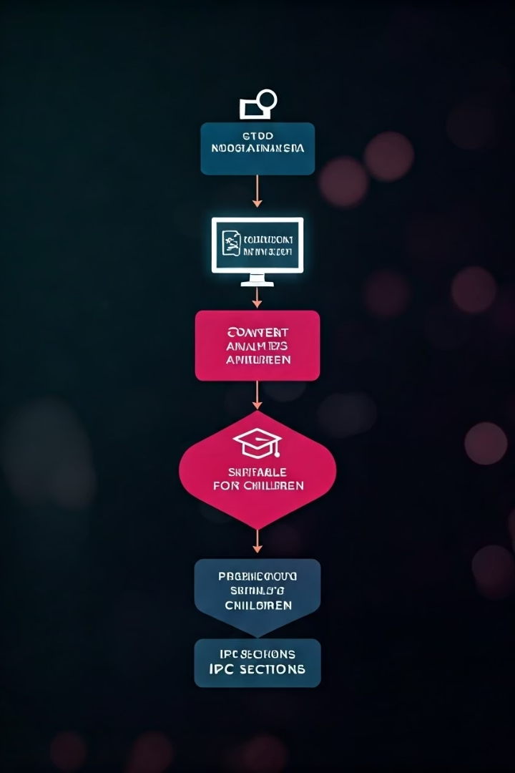




System Architecture
Video Input
Accepts video files (.mp4,.).
Audio Extraction
Uses Whisper-openai for transcription.
Text Cleaning
Regex removes asterisks and special characters.
Offensive Word Match
Compares cleaned text against a list.
The system then counts offensive words and predicts suitability for children and relevant IPC sections.

Slide 5





Technology Stack
Python
Whisper
MoviePy
re Library
The project utilizes Python as the programming language. OpenAI's Whisper is used for speech recognition. MoviePy is used as the video editing library, and the re library handles regular expressions.

Slide 6
Data Preprocessing & Cleaning
Whisper Challenges
Regex Cleaning
Accuracy
Removes asterisks
Background Noise
Handles slang
Indian Accents
Normalizes case
Data preprocessing involves addressing Whisper's accuracy limitations, background noise, and Indian accents. Regex cleaning removes asterisks and special characters. Case normalization ensures consistent matching.

Slide 7
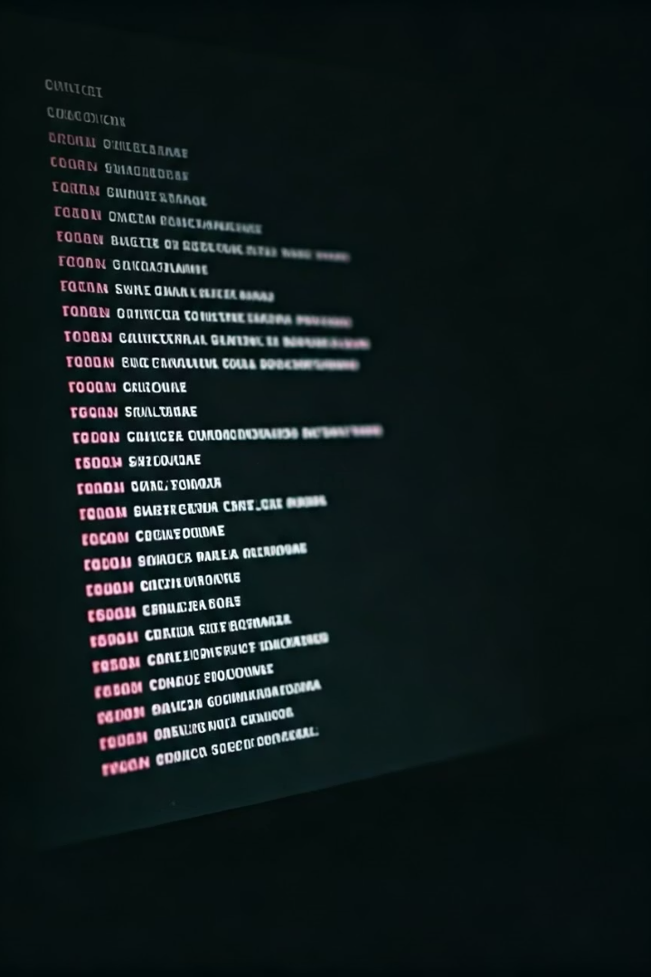
Offensive Word List
Comprehensive List
Handling Variations
Creation of an extensive list of offensive English words.
Accounts for plural forms and different spellings.
Matching Algorithm
Uses case-insensitive and fuzzy matching.
The project uses a comprehensive list of offensive words in English. It handles variations in plural forms, spellings, and contextual usage. The matching algorithm is case-insensitive.

Slide 8




Predicting Child-Friendliness
Video Transcription
Feature Extraction
1
2
4
3
Evaluation
Training
Firstly, whisper transcript the audio to text . Then Extract features like offensive word count. Training and validation processes involve splitting data and tuning hyperparameters. Evaluation metrics can determine if a video is good for children.

Slide 9
Predicting IPC Sections
Mapping
1
Map offensive words to IPC.
Challenges
2
Address ambiguity.
Approach
3
Use multi-label classification.
The goal is to predict relevant Indian Penal Code (IPC) sections based on offensive words. Challenges include ambiguity and multiple sections for a single word.

Slide 10
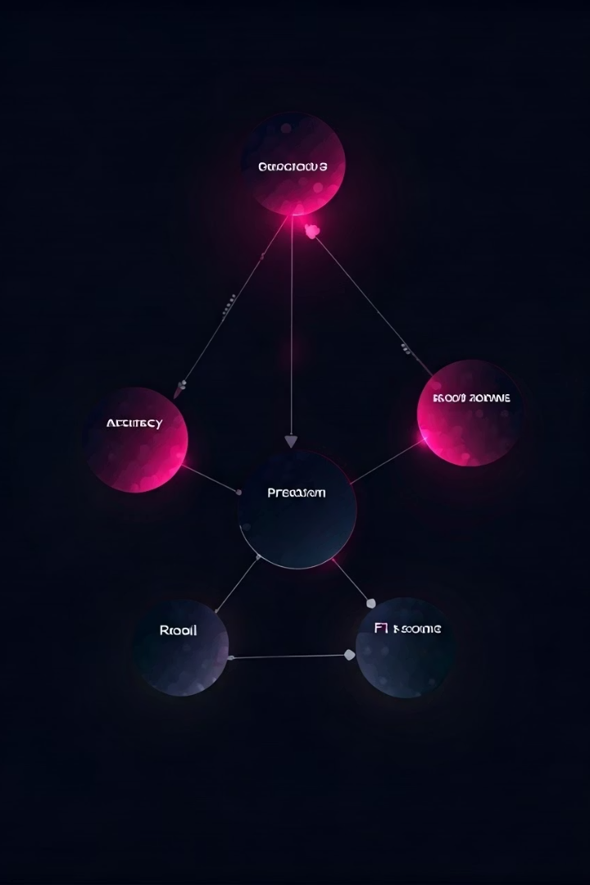
Results & Performance Analysis
80%
85%
Overall Accuracy
Child Prediction
75%
IPC Prediction
The system's performance is measured by overall accuracy, Whisper ASR performance (Word Error Rate), child-friendliness prediction accuracy, and IPC section prediction accuracy. The results highlight successful detections and limitations.

Slide 11
PROGRAM CODE

Slide 12
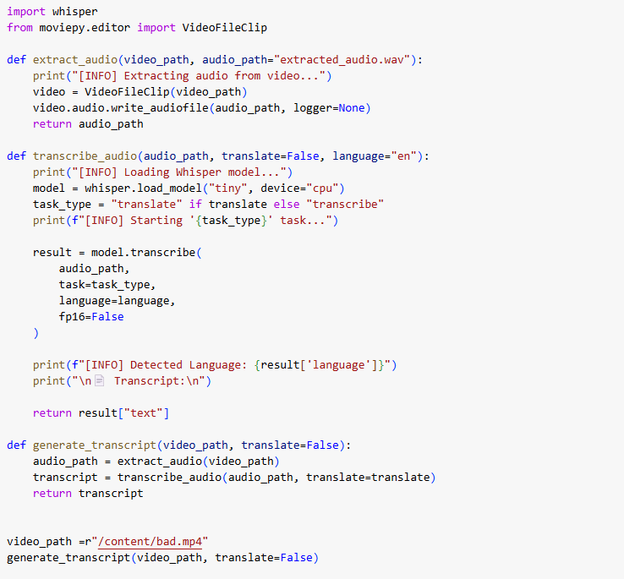

Slide 13
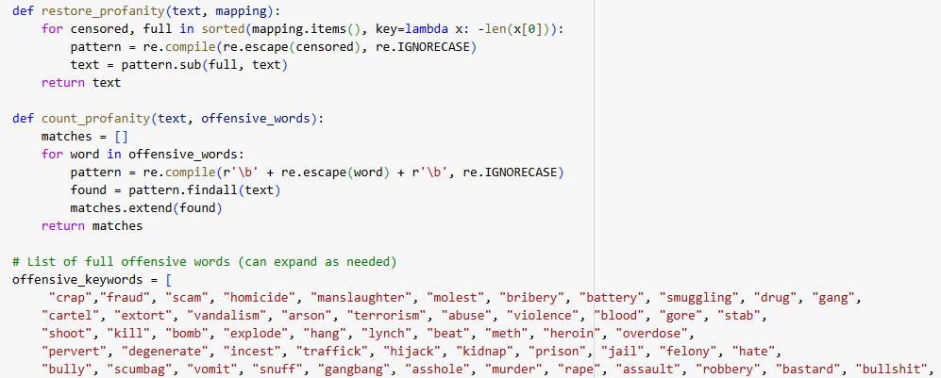

Slide 14
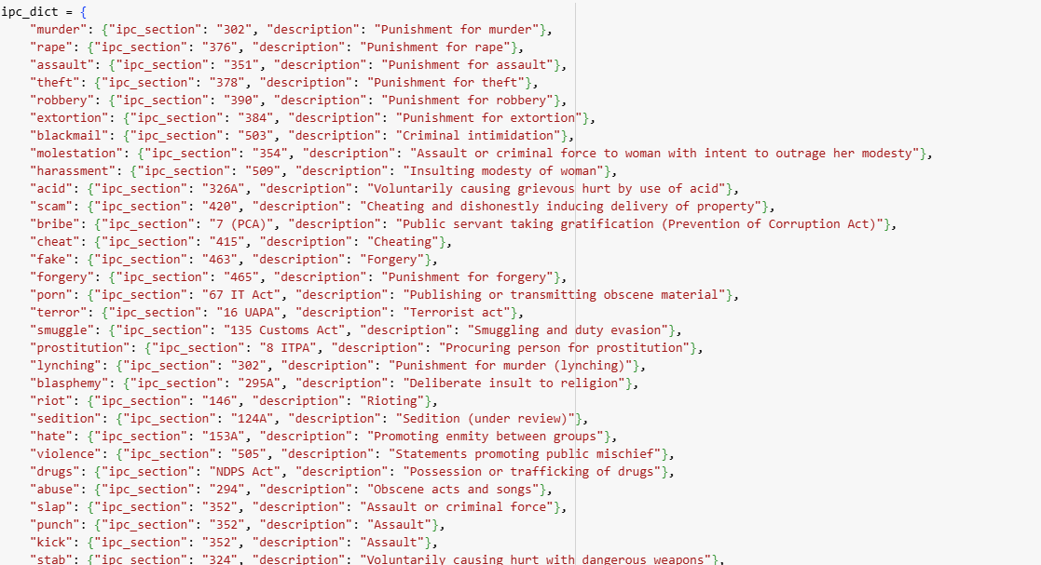

Slide 15
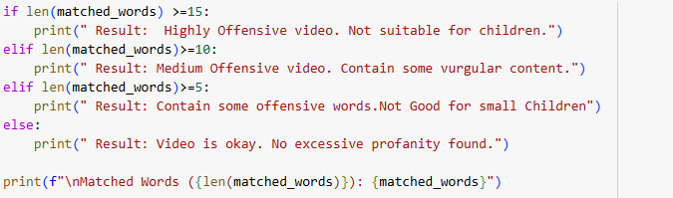

Slide 16
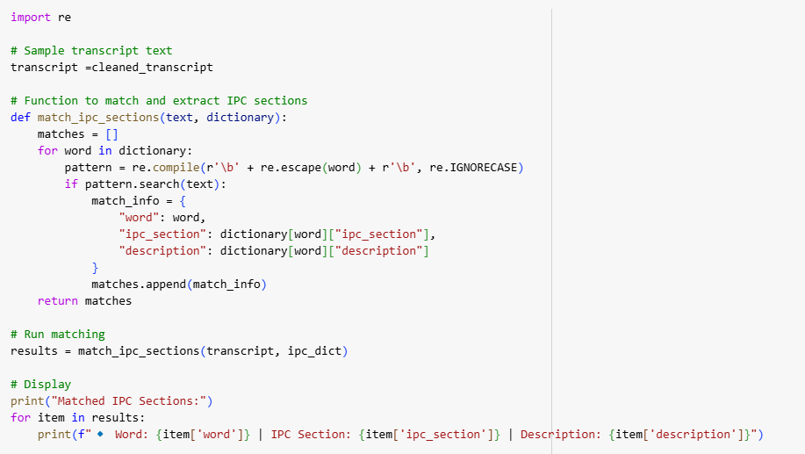

Slide 17
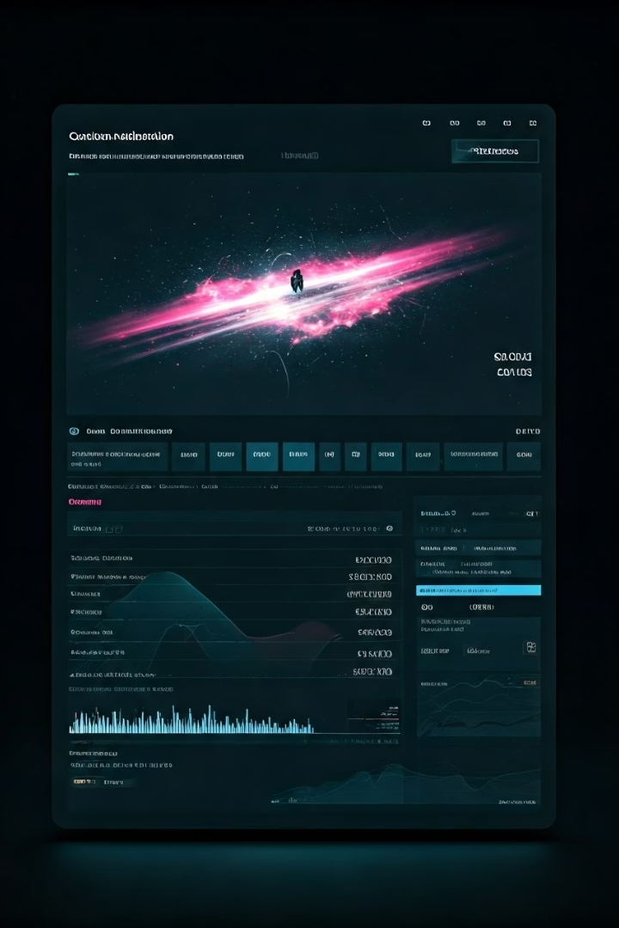
Conclusion & Future Scope
Feasibility
Impact
Automated detection is feasible.
Ensures a safer online environment.
Future
Improve accuracy and expand languages.
The project proves the feasibility of automated offensive content detection. Future enhancements include improving Whisper ASR, expanding the offensive word list, and incorporating contextual understanding. Deployment as a web service is also planned.

Slide 18
THANK YOU

